Slide 1
Welcome to ist 263
Intro to Front End Web Development

Slide 2
Agenda
Who am I? Who are you?
Corona Lab Procedures
Attendance/Virtual Schedule
About the Class
History of the Internet
How the Web Works

Slide 3
Who am I? Who are you?

Slide 4
Who am I?
Professor Ferger
Web Application Developer
I’ve been programming the front and backend of the web since 1999.

Slide 5

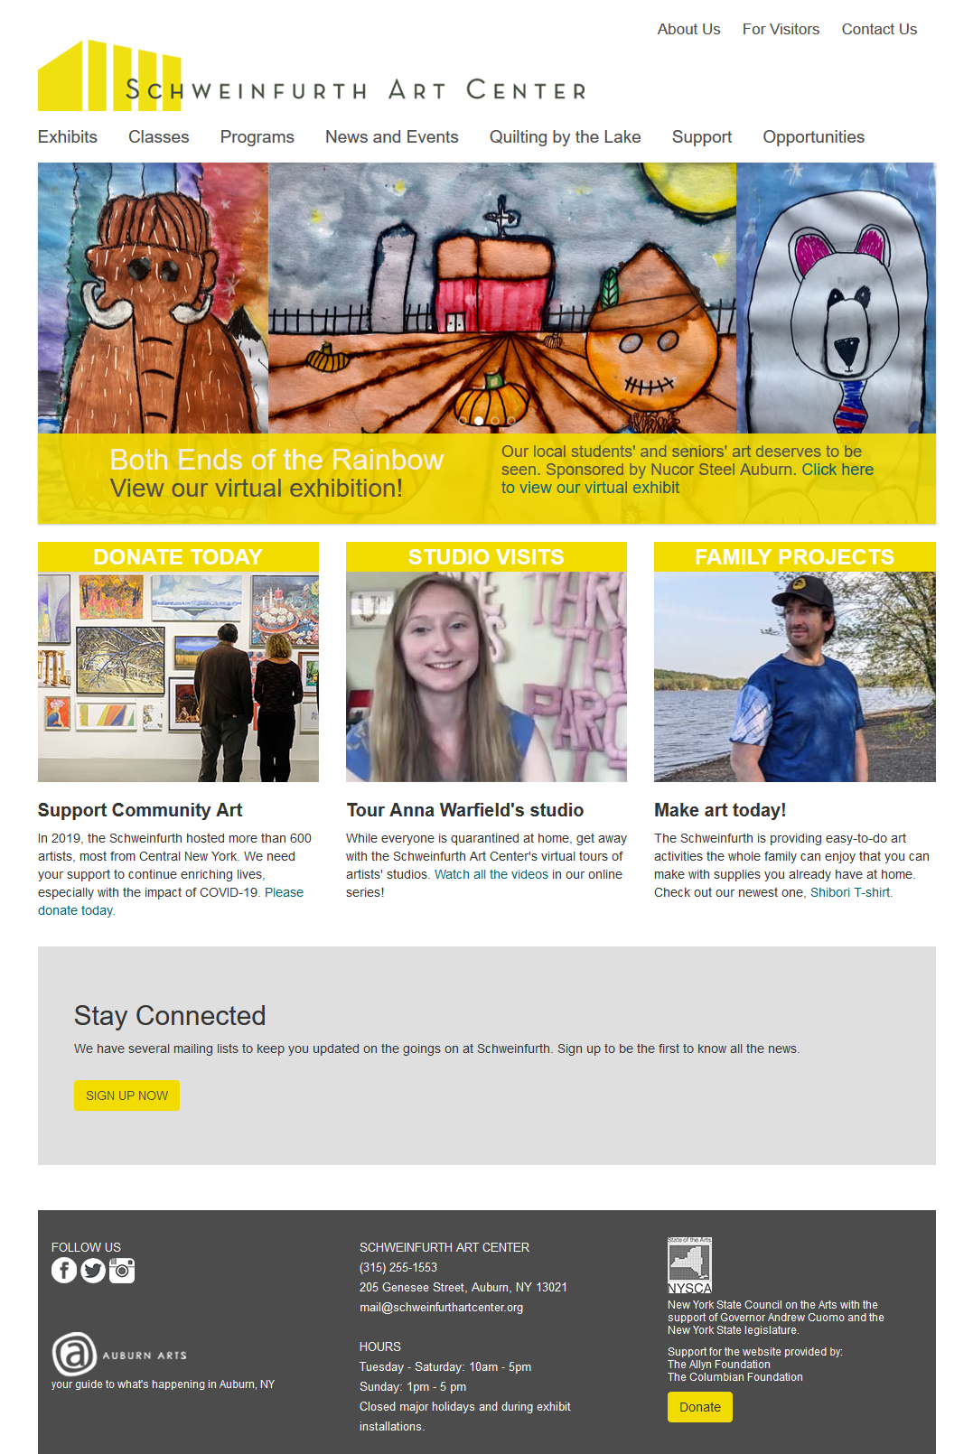

Slide 6

Where am I?
Office Hours:
MS Teams
or
Hinds 206F
Tues/Thurs 1:20-2:20pm

Slide 7
Connect to Teams

Slide 8
Who are you?
What school?
iSchool or dual / architecture / arts and sciences / education / engineering and computer science / falk / law / whitman / maxwell / newhouse / vpa
What year are you?
Who has previous coding experience?
Who has taken a class with me before?

Slide 9
Who are you? Group Activity
Two truths and a lie
Write three statements about your self: 2 true and 1 false.
Ask your partner to vote on which statements are true and which is false.
Reveal which statements were true and which false.

Slide 10
My Two Truths and a Lie
I’ve developed for a fortune 500 companies.
I’ve developed phone apps.
I’ve developed website shopping carts.

Slide 11
Corona Procedures

Slide 12

Threat Level
Threat level red means wearing a mask that covers the nose and mouth at all times.

Slide 13
About the Class

Slide 14
What will you learn in this class?
HTML, CSS and JavaScript
Web development language and concepts
How to craft & design a functional website

Slide 15

Class Requirements
Bring your laptop to class every day.
Textbook: Learning Web Design: A Beginner's Guide to HTML, CSS, JavaScript, and Web Graphics

Slide 16
Blackboard
Tour of Blackboard

Slide 17
General Policies
No late work accepted.
No makeup exams or exams at alternate times.
No mobile phone use in class unless it’s needed for lesson.
All due dates are posted in the syllabus today. Plan accordingly.

Slide 18
Weekly Labs
Due Saturday at 11:59pm submitted to blackboard.syr.edu

Slide 19
Exams
2 Exams
Worth 100 points each

Slide 20
Projects
There is one project worth 120 points.
The project will be split into parts due throughout the semester.

Slide 21
Weekly Participation
5 points are allotted for participation. To earn these points, you must:
Attend class and come on time. Joining a couple minutes after start time is not on time.
Be engaged in class. Ask questions. Be able to answer questions I ask. Work on lab during lab time.
If you are joining the class virtually respond when I ask you a question.
Complete participation activities and turn them in at end of class.
Participation is all or nothing.

Slide 22
Absence
If you can’t attend class let me know before class starts.

Slide 23
Class Flow
Due | Item
Tuesday by start of class | read textbook
Saturday by 11:59pm | complete lab
Sunday 11:59pm (every other) | turn in a part of the project
Please check the syllabus and mark the important dates on your calendar.

Slide 24
Grades
Assessment | Quantity | Points Each | Total Points | Part of Grade
Participation | 12 | 5 | 60 | 12%
Labs (lowest grade dropped) | 12 | 10 | 120 | 24%
Exams | 2 | 100 | 200 | 40%
Project | 1 | 120 | 120 | 24%

Slide 25
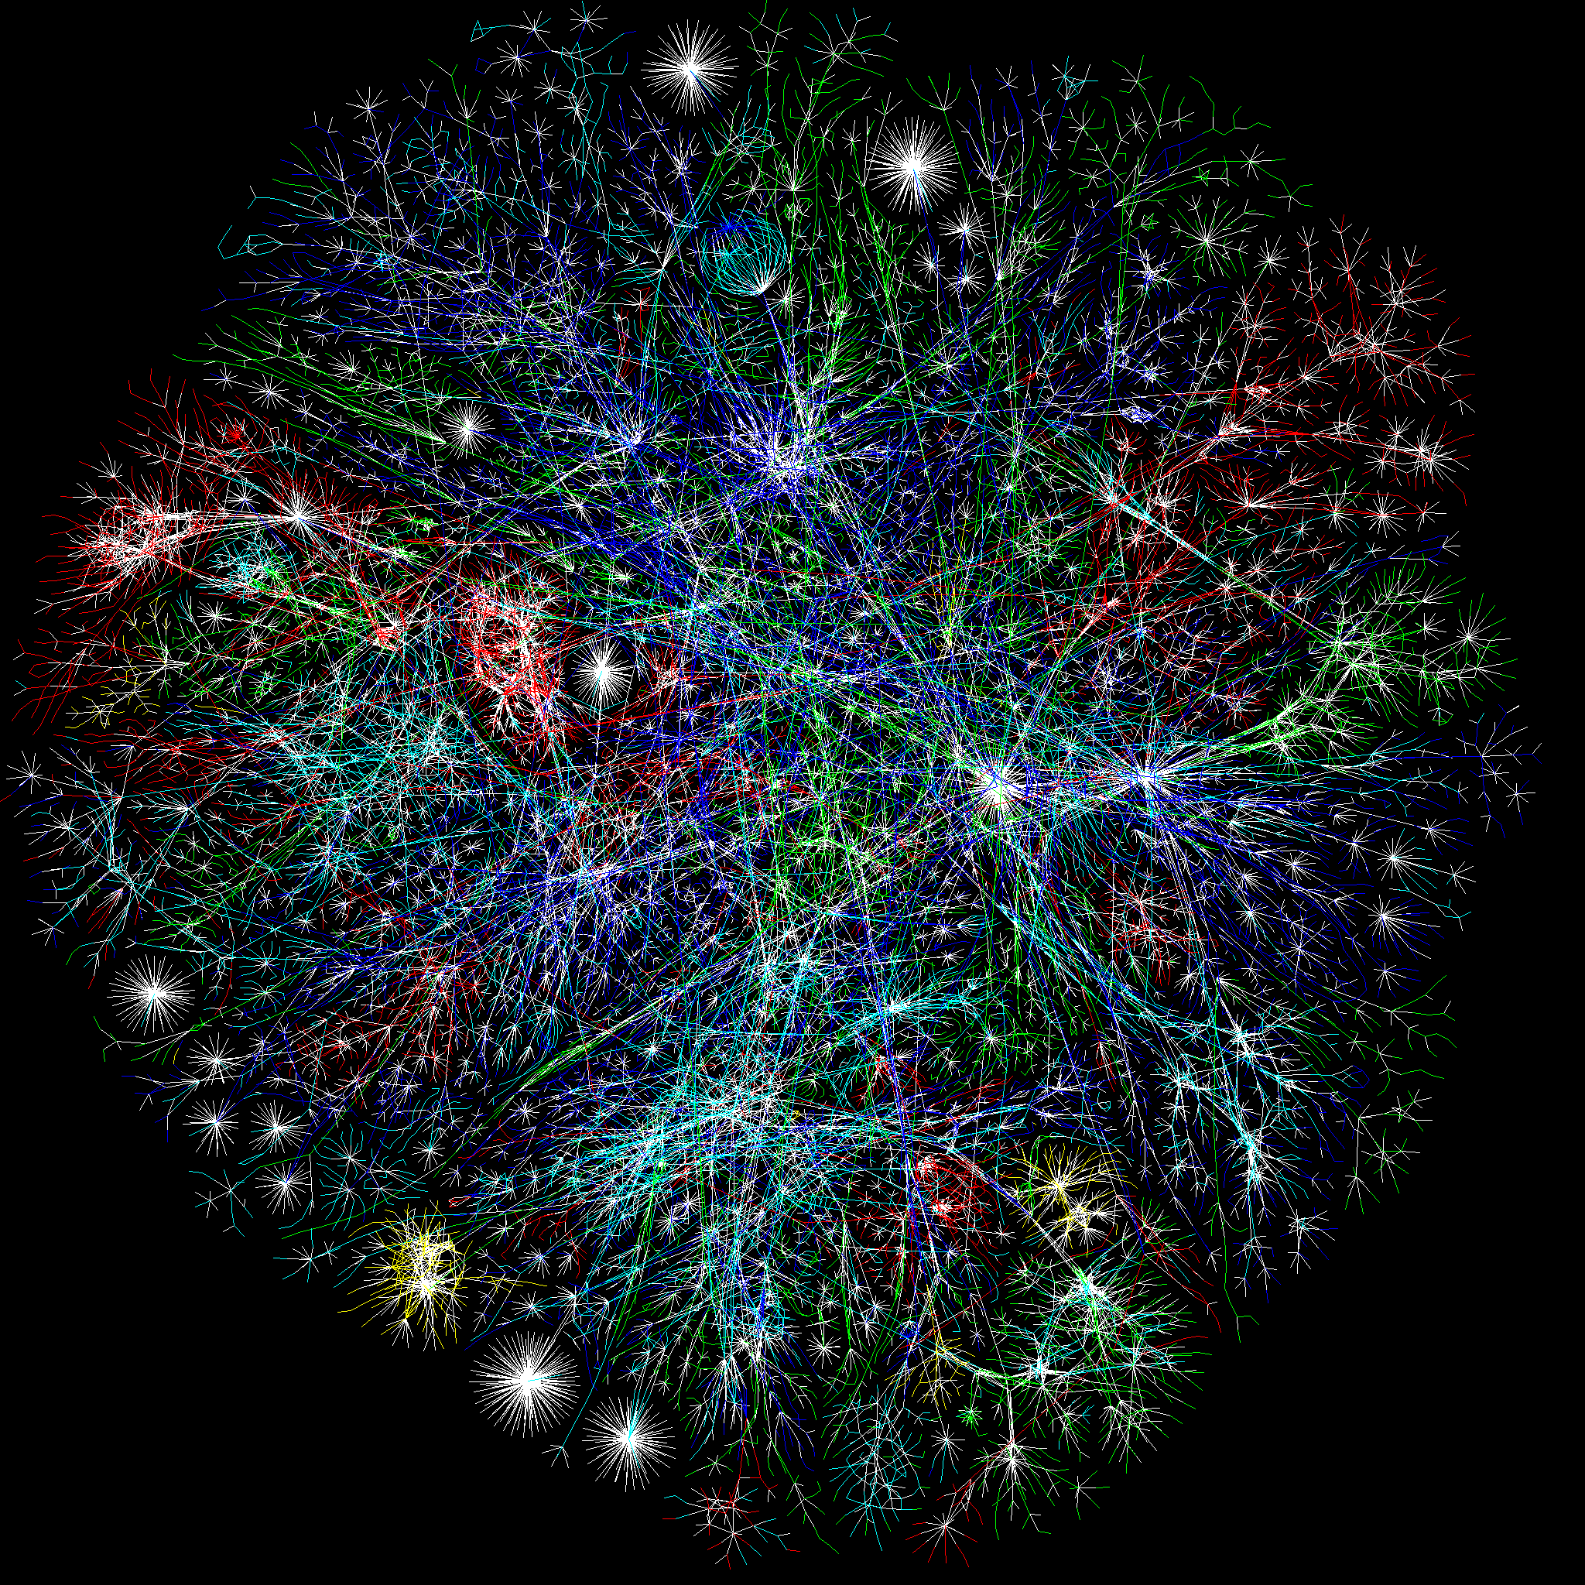
History of the Internet

Slide 26

What is the difference between the internet and the web?
This Photo by Unknown Author is licensed under CC BY-SA

Slide 27
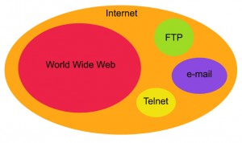
Difference Between Web and Internet

Slide 28
What decade was the internet conceived?
1940s
1950s
1960s
1970s
This Photo by Unknown Author is licensed under CC BY-SA

Slide 29
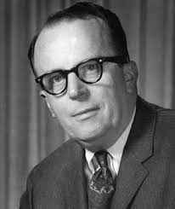
When was the idea of the internet conceived?
1962 Licklider of MIT
Proposed the idea of a network of computer that could talk to each other.
"

Slide 30
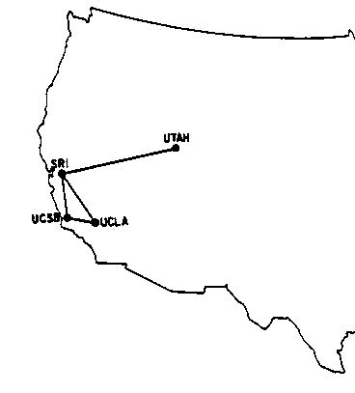
What was the first message sent on the ARPAnet?
1969 First Message Sent
First message was sent from UCLA to Stanford: “LOGIN”— it crashed the fledgling ARPA network anyway: The Stanford computer only received the note’s first two letters.
There were 4 computers on the network in 1969.
By early 1970’s several networks like ARPAnet had been developed.

Slide 31
What decade was email invented?
1960s
1970s 1980s
1990s
This Photo by Unknown Author is licensed under CC BY-SA

Slide 32

When was the idea of email conceived?
1971 Ray Tomlinson Develops Email
Came up with @ symbol to tell the difference between person and location in an email address.

Slide 33
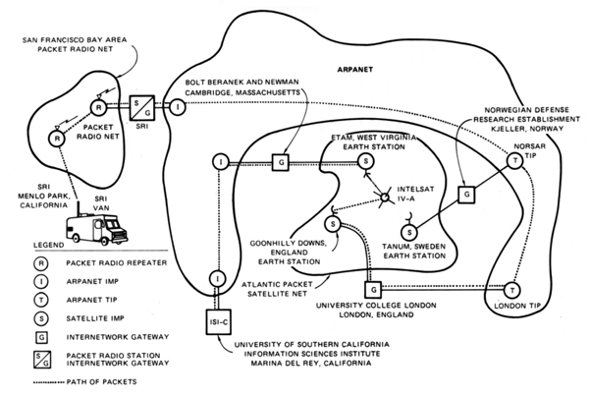
Modern technology that united all computers on early networks: TCP/IP
1971 Vincent Cerf Unifies Lots of Mini Networks Like ARPANet
Developed transmission control protocol to help computers talk to each other.
Diagram of the first internetworked connection

Slide 34
Who used the internet in the 1980’s
Throughout the 1980s, researchers and scientists used it to send files and data from one computer to another.

Slide 35
What decade was the web invented?
1960s
1970s 1980s
1990s
This Photo by Unknown Author is licensed under CC BY-SA

Slide 36

When was the World Wide Web Invented?
In 1991 Tim Berners-Lee (working at CERN) introduced the World Wide Web.
helped solve the difficulties scientists were having sharing information.
created HTML
created URLs
developed HTTP the protocol
director of the World Wide Web Consortium (W3C), which oversees the continued development of the Web.
In a list of 80 cultural moments that shaped the world, chosen by a panel of 25 eminent scientists, academics, writers and world leaders, the invention of the World Wide Web was ranked number one.

Slide 37
The first popular web browser was called:
Mosaic
allowed users to see words and pictures on the same page for the first time
to navigate using scrollbars and clickable links
1993
That same year, Congress decided that the Web could be used for commercial purposes.
Companies hurried to set up websites of their own, and e-commerce entrepreneurs began to use the Internet to sell goods directly to customers.

Slide 38
What was the first thing purchased on the internet?
Clothes
Books
Food
This Photo by Unknown Author is licensed under CC BY-SA

Slide 39

First thing purchased on the internet

Slide 40
How the Web Works

Slide 41
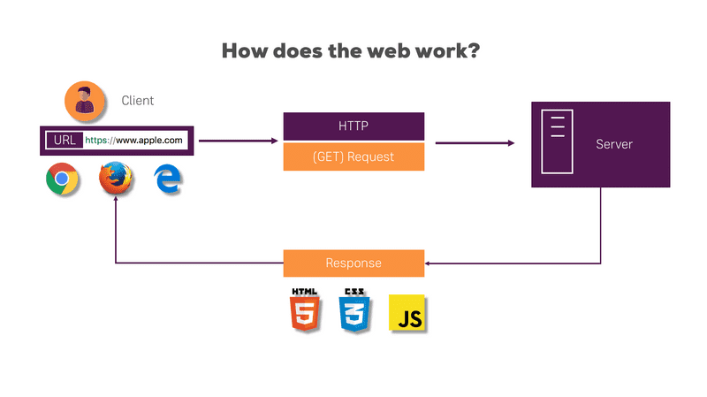

Slide 42
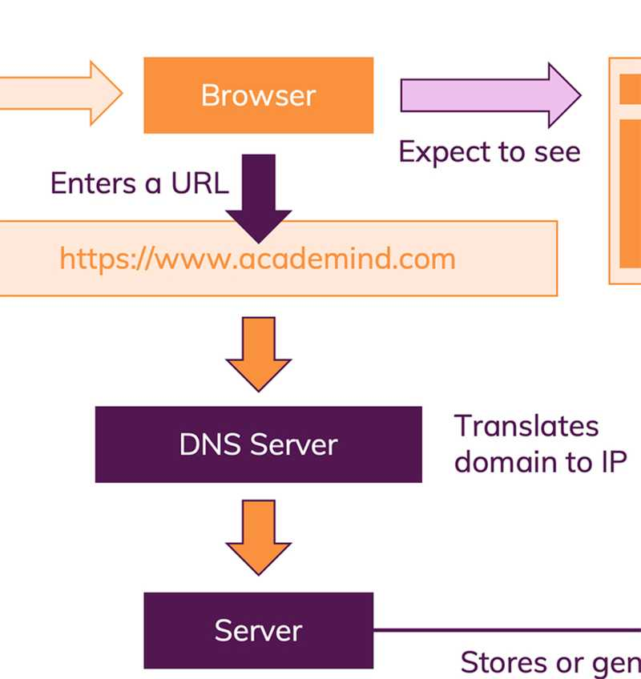

Slide 43
Vocabulary of a Web Address
URL | http://google.com
Protocol | https://maps.google.com http://maps.google.com
Host name / IP Address | google.com, 192.168.0.0
Port | https://maps.google.com:8080
Top-level-domain | .com, .net, .edu, .co, .uk, etc.
Sub-domain | http://its.syr.edu/visitors/visitors-future.html

Slide 44
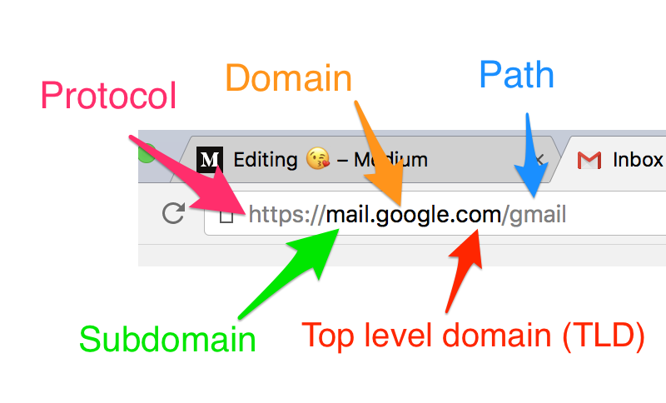

Slide 45
A Basic Web Page
Web pages are text
The extension at the end of the file tells the browser how to interpret the files.
.htm or .html means that you are sending the browser an HTML file
index.hml is a common name for a website’s home page

Slide 46
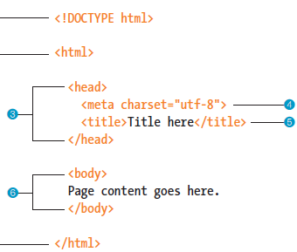
What does the text on the page look like?

Slide 47
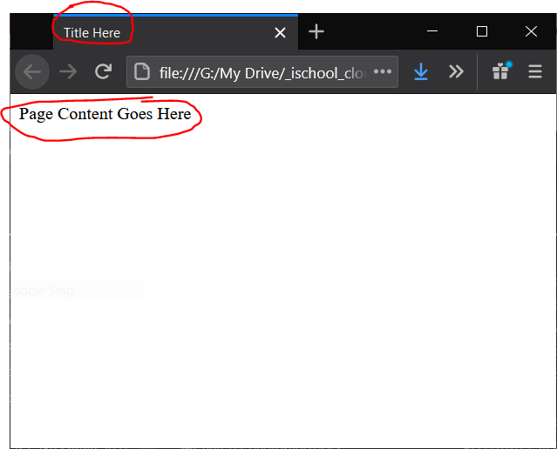
What will the user see in the browser?

Slide 48
Questions?

